Slide 1
Design of Embedded Systems

Slide 2






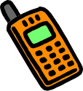
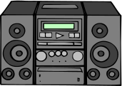


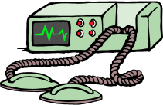



A “short” list of Embedded Systems
Auto focus cameras
ATMs
Avionic systems
Automatic transmission
Battery Chargers
Camcorders
Cell phones
Cordless Phones
Digital Cameras
DVD players
Electronic Toys/Games
Fax machines
Medical Equipment
Microwave ovens
Modems
Network cards
Pagers
PDAs
Photocopiers
Portable Video games
Pont of Sales terminals
Printers
Scanners
Satellite phones
Teleconferencing systems
Televisions
Set-top boxes
VCR’s
Video phones
Washers and dryers
and many more ….

Slide 3
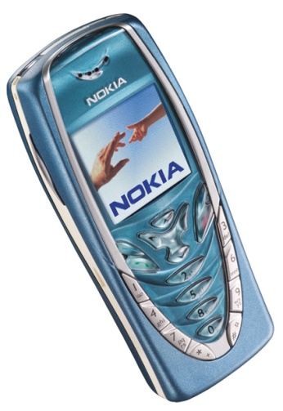
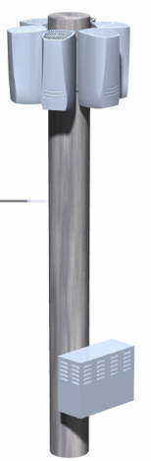
Embedded systems from real life
Mobile Phones and Base Stations
Multiprocessor
  8-bit/32-bit for UI; DSP for signals
  32-bit in IR port; 32-bit in Bluetooth
8-100 MB of memory
All custom chips
Massive signal processing
  Several processing tasks per connected call
Based on DSPs
  Standard or custom
  100s of processors

Slide 4
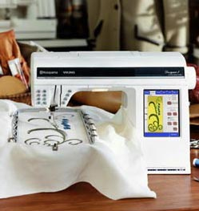
Embedded systems from real life
Sewing Machine
User interface
  Embroidery patterns
  Touch-screen control
”Smart”
  Sets pressure of foot depending on task
  Raise foot when stopped
New functions added by upgrading the software
Notes:
Stickerei

Slide 5
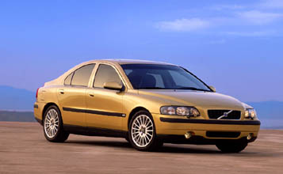
Embedded systems from real life
Multiple processors
  Up to 100
  Networked together
Multiple networks
  Body, engine, telematics, media, safety
Cars
Functions by embedded processing:
  ABS: Anti-lock braking systems
  ESP: Electronic stability control
  Airbags
  Efficient automatic gearboxes
  Theft prevention with smart keys
  Blind-angle alert systems
  ... etc ...
Large diversity in processor types:
  8-bit – door locks, lights, etc.
  16-bit – most functions
  32-bit – engine control, airbags

Slide 6



Embedded systems from real life
Smart Beer Glass
Capacitive sensor for fluid level
8-bit, 8-pin
PIC processor
Contact less transmission of power and readings
Inductive coil for RF ID activation & power
CPU and reading coil in the table. Reports the level of fluid in the glass, alerts servers when close to empty

Slide 7
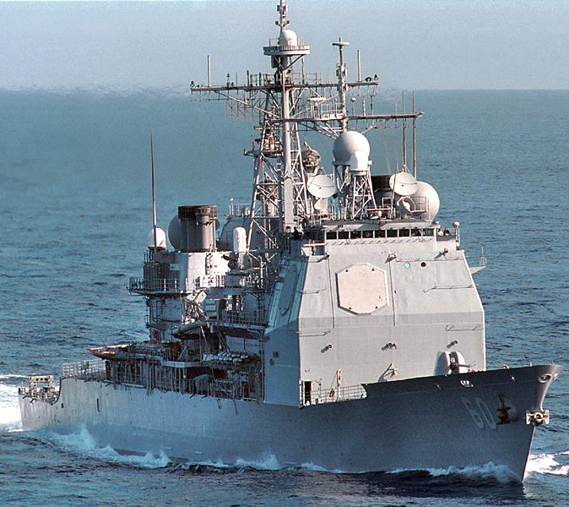
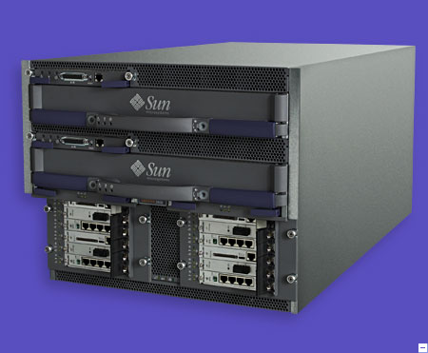
Embedded systems from real life
Extremely Large
Functions requiring computers:
  Radar
  Weapons
  Damage control
  Navigation
  basically everything
Computers:
  Large servers
  1000s of processors

Slide 8

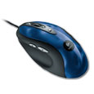
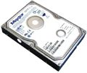
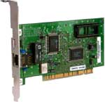
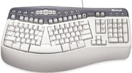

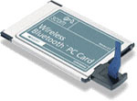
Embedded systems from real life
Inside Your PC
Custom processors
  Graphics, sound
32-bit processors
  IR, Bluetooth
  Network, WLAN
  Harddisk
  RAID controllers
8-bit processors
  USB
  Keyboard, mouse

Slide 9




Characteristics of Embedded Systems
  Must be dependable,
    Reliability R(t) = probability of system working correctly provided that is was working at t=0
    Maintainability M(d) = probability of system working correctly d time units after error occurred.
    Availability A(t): probability of system working at time t
    Safety: no harm to be caused
    Security: confidential and authentic communication
  Even perfectly designed systems can fail if the assumptions about the workload and possible errors turn out to be wrong.
  Making the system dependable must not be an after-thought, it must be considered from the very beginning

